Slide 1
컴퓨터 네트워크 Computer Networks and Internets, 6e

Slide 2
TCP: Reliable Transport Service

Slide 3
Assignment
Explain how we can get reliable transfer through unreliable protocol UDP.
2. The following is a dump of a UDP header; 0045DF0000580000
1) Is the packet directed from a client to a server or vice versa?
2) What is the length of the data?
3) How the sender handled checksum for this packet?
3. Capture various Ethernet frames using Wireshark, and explain fields in the Ethernet, IP, and UDP header.
© Pearson Education Inc., Upper Saddle River, NJ. All rights reserved.
3
Notes:
3

Slide 4
© Pearson Education Inc., Upper Saddle River, NJ. All rights reserved.
4
Notes:
4

Slide 5
Introduction
This chapter
considers transport protocols in general
examines TCP
the major transport protocol used in the Internet
explains how the TCP protocol provides reliable delivery
reviews the service that TCP provides to applications
examines the techniques TCP uses to achieve reliability
TCP
The primary transport-layer protocol used in the Internet
Accounts for about 90% of all Internet traffic (some estimates are higher)
Provides reliability
Appeals to programmers

Slide 6
The Service TCP Provides to Applications
End-to-end communication
Connection Orientation
Point-to-Point Communication
each TCP connection has exactly two endpoints
Complete Reliability
Full Duplex Communication
allows data to flow in either direction
Stream Interface
an application sends a continuous sequence of octets
Reliable Connection Startup
Graceful Connection Shutdown
insures that both sides have agreed to shut down the connection

Slide 7
End-to-End Service and Virtual Connections
TCP is classified as an end-to-end protocol
it provides communication between an application on one computer to an application on another computer
The connections in TCP are called virtual connections
because connections are achieved in software
Allows an application on one host to communicate with an application on another host
Permits multiple applications on a given computer to communicate simultaneously without interference
Uses protocol port numbers to distinguish among applications
Note: TCP ports are completely independent of UDP ports

Slide 8
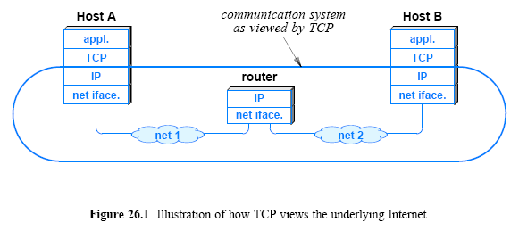
End-to-End Service and Virtual Connections
Transport protocols operate in end systems, and view the underlying Internet as a virtual network
IP does not read or interpret TCP packets

Slide 9
TCP Protocol Port Numbers
16-bit integers used to identify applications
TCP well-known port assignments are independent of UDP assignments
However, to help humans, the same value chosen if service
available via either transport
Both UDP and TCP assign port 53 to the Domain Name System
Both UDP and TCP assign port 7 to the echo service
Key concept: because a TCP connection corresponds to a pair of endpoints, the connection is identified by four items
IP source address, TCP source port, IP destination address, TCP destination port
Commonly called the four-tuple
Explains how an application such as a web server can
communicate with multiple clients at the same time

Slide 10
Techniques That Transport Protocols Use
The major problems/issues to be considered, such as
Unreliable Communication
can be lost, duplicated, corrupted, delayed, or delivered out of order
End System Reboot
either of the two end systems might crash and reboot
Heterogeneous End Systems
A sender can generate data so fast that it overruns a slow receiver
Congestion in the Internet
to compensate for bits that are changed during transmission
parity bits, checksum, CRC
Transport protocols do more than detect errors

Slide 11
Techniques That Transport Protocols Use Sequencing Handle Duplicates and Out-of-Order Delivery
To handle duplicate packets and out-of-order deliveries
transport protocols use sequencing
The sender attaches a sequence number to each packet
The receiver stores both the sequence number of the last packet received in order
as well as a list of additional packets that arrived out of order
The receiver examines the sequence number
to determine how the packet should be handled
If the packet has already been delivered or the sequence number matches one of the packets waiting on the list
the software discards the new copy
© Pearson Education Inc., Upper Saddle River, NJ. All rights reserved.
11
Notes:
11

Slide 12
TCP Reliability
Uses timeout-and-retransmission
Receiver returns an acknowledgement (ACK) to sender when data arrives
Sender waits for acknowledgement and retransmits data if no acknowledgement arrives

Slide 13
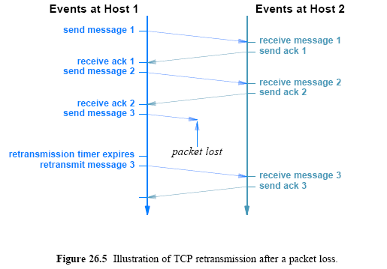
TCP retransmission

Slide 14
Why TCP Retransmission Is Hard
TCP designed for Internet
Round-trip delays differ among connections
Round-trip delays vary over time
Waiting too long introduces unnecessary delay
Not waiting long enough sends unnecessary copies
Key to TCP’s success: adaptive retransmission
Continually estimate round-trip time of each connection
Set retransmission timer from round-trip estimate
© Pearson Education Inc., Upper Saddle River, NJ. All rights reserved.
14
Notes:
14

Slide 15
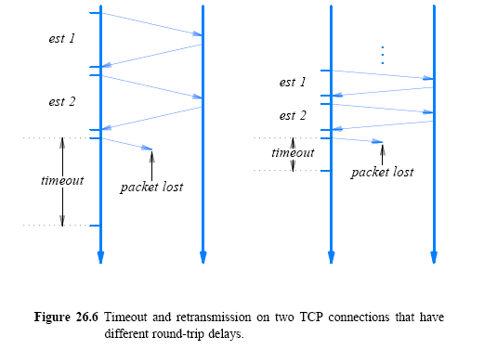
timeout on two connections

Slide 16
Techniques That Transport Protocols Use Sliding Window
Transport protocols use sliding window mechanism
Sliding window can increase throughput dramatically
send multiple packets before waiting for an acknowledgment
Window size is relatively small (tens of packets, not millions)
© Pearson Education Inc., Upper Saddle River, NJ. All rights reserved.
16
Notes:
16

Slide 17
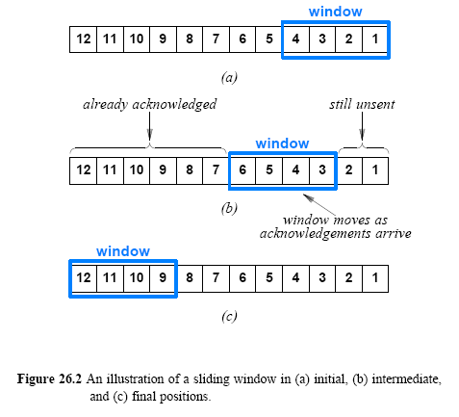
Techniques That Transport Protocols Use Sliding Window

Slide 18
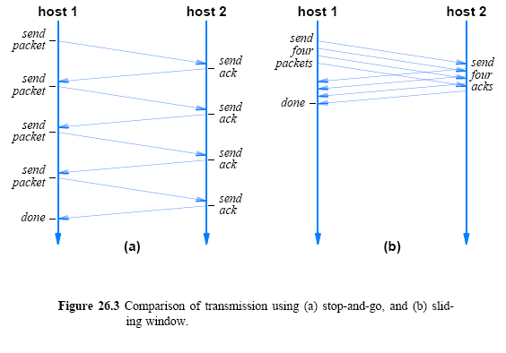
Techniques That Transport Protocols Use Sliding window improves data rate

Slide 19
Techniques to Avoid Congestion
TCP uses loss or changes in delay to infer congestion in the network
When congestion(packet loss) is detected, sending TCP temporarily reduces the size of the window
Then, TCP increases the window
Slow start also used when a connection starts
Temporarily use a congestion window(cwnd) size of one segment
Double the window size when ACK arrives
Congestion avoidance
When Ssthreshold is reached, TCP slows the rate of increase
Increase the window size +1MSS when ACK arrives
Packet Loss:
- Ssthreshold: ½ of cwnd and slow start
© Pearson Education Inc., Upper Saddle River, NJ. All rights reserved.
19
Notes:
19

Slide 20
Techniques That Transport Protocols Use Flow Control Prevents Data Overrun
Techniques are available to prevent a fast computer from sending so much data to overrun a slower receiver
Flow control techniques are employed to handle the problem
Flow control mechanism coordinates data being sent with receiver’s speed
Buffer size used instead of data rate
Receiver tells sender size of initial buffer
Each acknowledgement specifies space remaining in buffer
Delayed ACK, Nagle Algorithm
Known as window advertisement (rwnd)
© Pearson Education Inc., Upper Saddle River, NJ. All rights reserved.
20
Notes:
20

Slide 21
Buffers, Flow Control, and Windows
If the receiver can read data as quickly as it arrives
a receiver will send a positive window advertisement along with each ACK
If the sender operates faster than the receiver
incoming data will eventually fill the receiver's buffer
causing the receiver to advertise a zero (0) window
A sender that receives a zero window advertisement
must stop sending
until the receiver again advertises a positive window
When sending use the size of sliding window as min(cwnd, rwnd).
© Pearson Education Inc., Upper Saddle River, NJ. All rights reserved.
21
Notes:
21

Slide 22
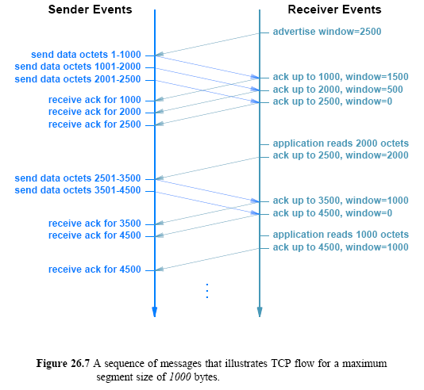
Buffers, Flow Control, and Windows

Slide 23
Assignment
Choose all features of TCP.
① Message Interface ② Connection-oriented ③ simplex
④ best effort ⑤ retransmission ⑥ end-to-end
2. Show the growth of window size caused by slow start and congestion control.
3. Which of UDP and TCP is better for the communication between DNS server and client. (consists of two packets - DNS request, DNS reply)
4. Find an item which is caused by the packet loss.
① retransmission ② ACK ③ delayed ACK
④ congestion avoidance ⑤ larger window size ⑥ flow control
Send your solution to me by email. (Due date: Sat. /24PM)
This assignment will be used to check your attendance.
© Pearson Education Inc., Upper Saddle River, NJ. All rights reserved.
23
Notes:
23

